Slide 1
Robotics Safety in BC
Claude Code Multi-Agent Squad Demo

Slide 2

What is Robotics Safety?
Imaginary new TSBC-regulated technology
Industrial robots, service robots, and drone systems
CSA R100 Robotics Safety Code adoption
Technician certification: Class A, B, and C

Slide 3

The Application Stack
Angular 19 with standalone components
TSBC Design System: colors, typography, spacing
Angular Formly for dynamic form rendering
6-step licence application wizard

Slide 4

Multi-Agent Squad Workflow
PRD Reviewer validates requirements (Sonnet)
Senior Developer implements features (Opus)
Code Reviewer checks PRs for quality (Sonnet)
QA Tester runs tests and verifies (Haiku)

Slide 5
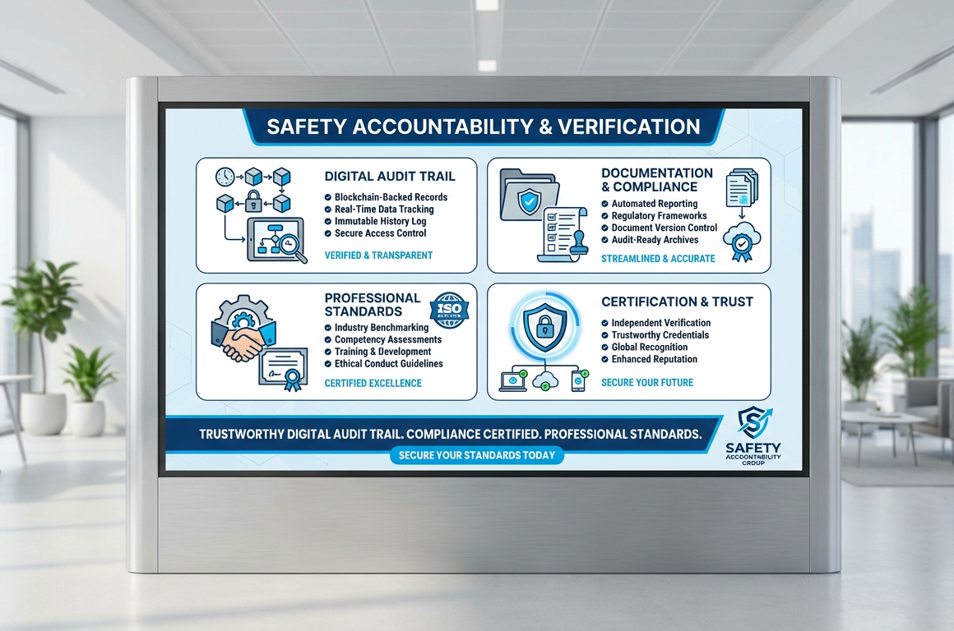
Key Features Built
Robotics technology landing page (14 sections)
Certification renewal page with accordions
Multi-step licence form with side panels
TSBC header, footer, hero, cards, CTA banners

Slide 6

Demo Highlights
74 unit tests passing with full coverage
ESLint + Angular ESLint quality gates
GitHub Issues, feature branches, and PRs
Live at localhost:4200/robotics

Slide 7
Technical Safety BC
Built with Claude Code
technicalsafetybc.ca

